Slide 1
How to use QIIME2: generate a feature table from raw sequencing data
2024.04.24 Phytobiome symposium
Session 1 Lee Seung Yeup

Slide 2
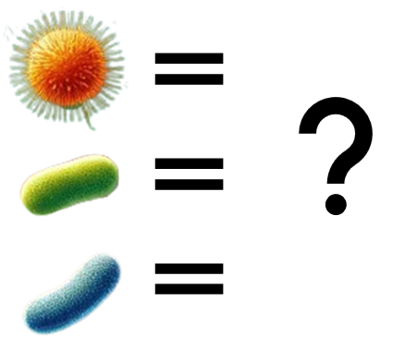

Microbiome analysis?
Feature table | A시료 | B시료 | C시료 | D시료 | …
E. coli | 10 | 5 | 6 | 9
Pseudomonas | 643 | 629 | 849 | 738
Xanthomonas | 1 | 0 | 1 | 1
Ralstonia | 50 | 54 | 59 | 68
Erwinia | 1 | 0 | 0 | 0
…

Slide 3

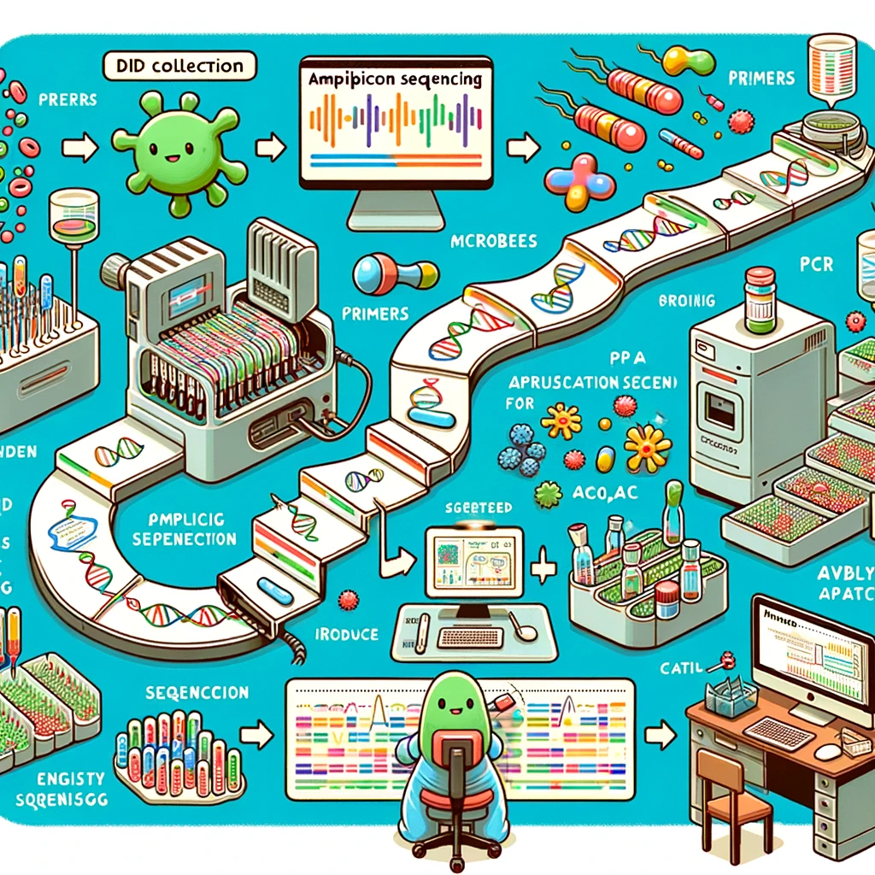
Shotgun metagenomic sequencing
Amplicon sequencing

Slide 4
Marker genes
16S rRNA gene
rpoB (β-subunit of RNA polymerase)
gyrB (DNA gyrase subunit B)
recA (Recombinase A)
...
Universal
Conservation
Variability
Availability

Slide 5
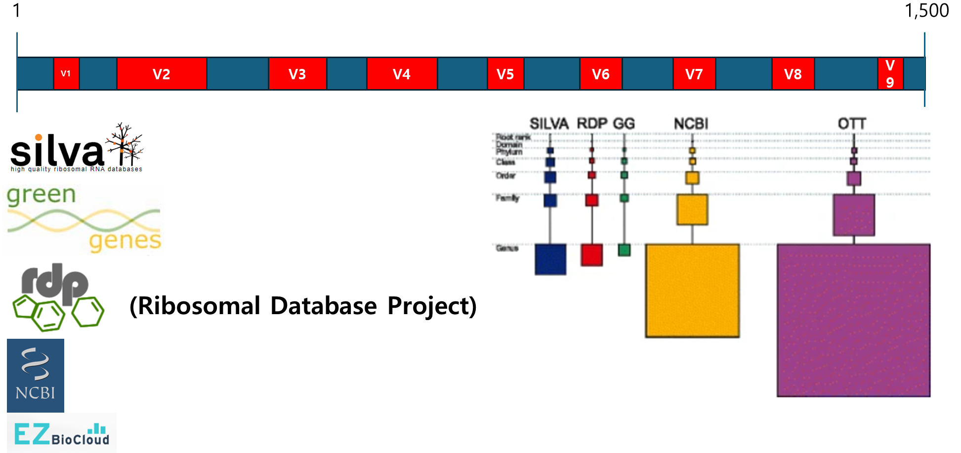
16S rRNA gene
(출처: Balvočiūtė and Huson, 2017. BMC genomics)

Slide 6
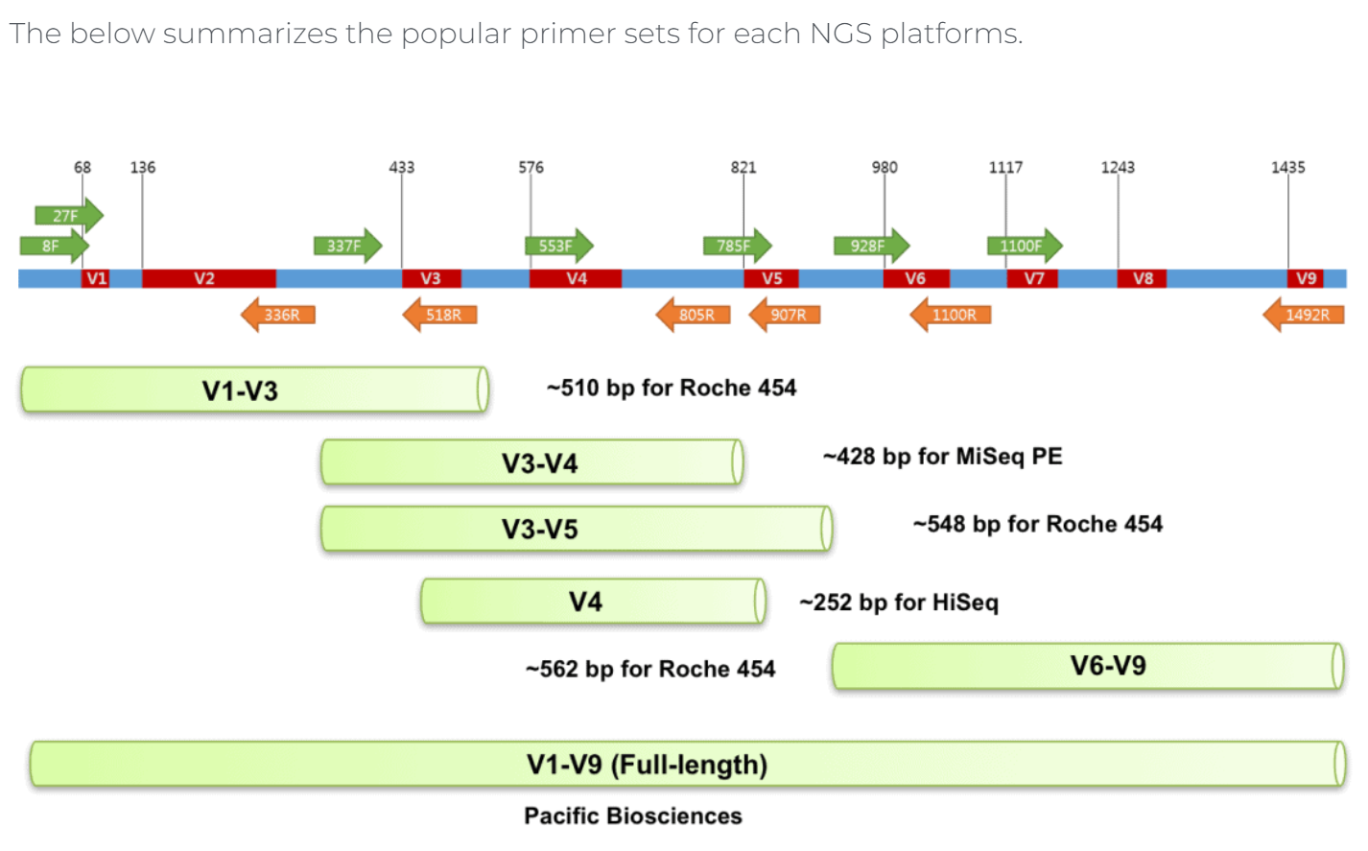
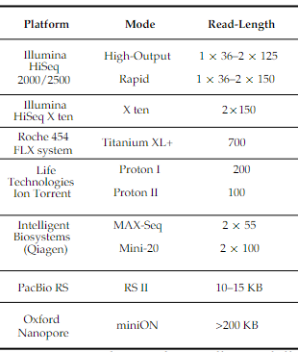
(출처: Xiao et al., 2016. Pharmaceutics)
(출처: EZBioCloud – 16S rRNA and 16S rRNA gene)

Slide 7
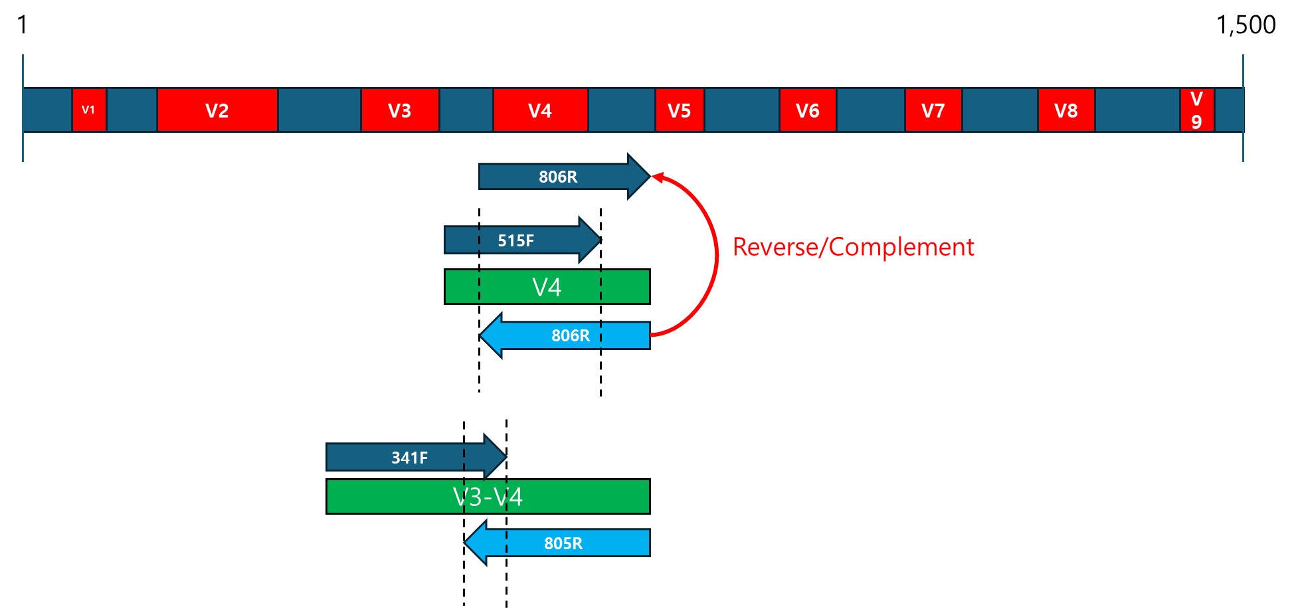
16S rRNA gene

Slide 8
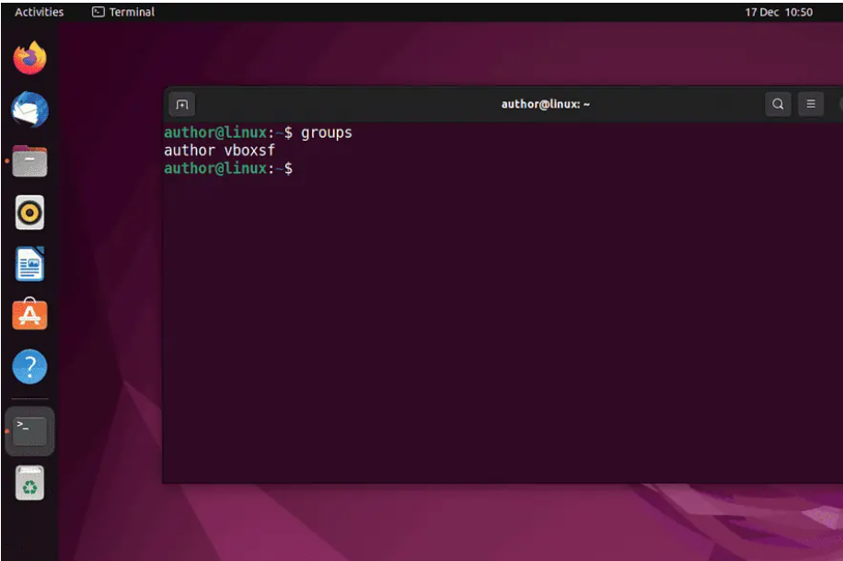
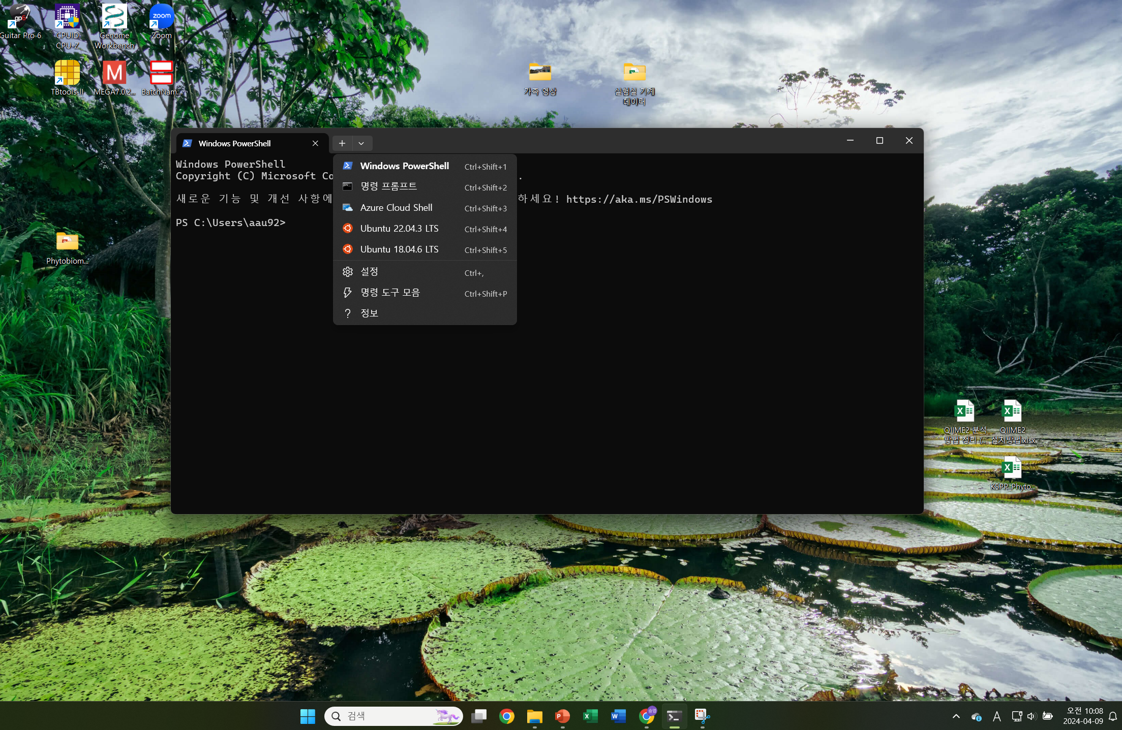
Linux
Linux를 OS로 설치한 경우
Window의 WSL2를 사용한 경우

Slide 9
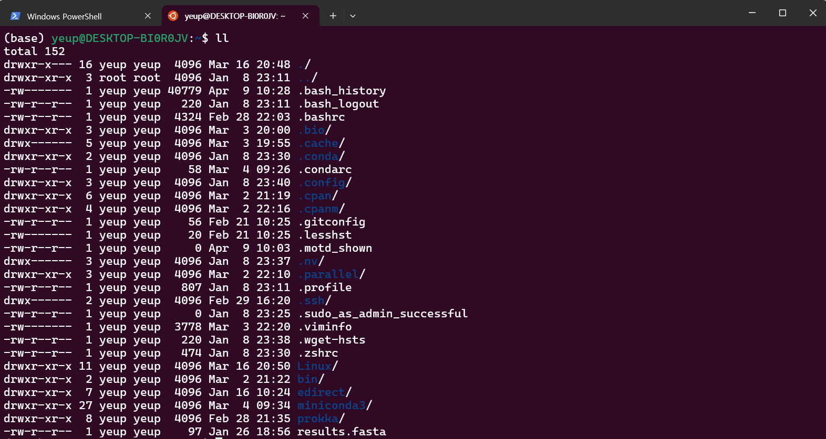
Linux
꼭 알아야 하는 명령어
Linux의 terminal 환경에서 작업을 하게 됨
‘cd’ : change directory의 약자로 위치를 옮길 때 사용
‘./’ : 현재 위치를 의미
‘../’: 이전 directory(위치)를 의미
‘ls’: 현재 directory안에 있는 files 또는 directory들을 확인 할 수 있다.
‘mkdir’: make directory의 약자로 directory를 생성
* ex) yeup@DESKTOP-BIOROJV:~$ -> cd Linux
->) yeup@DESKTOP-BIOROJV:~/Linux$ -> cd sampledata
->) yeup@DESKTOP-BIOROJV:~/Linux/sampledata$ -> cd ../
->) yeup@DESKTOP-BIOROJV:~/Linux$

Slide 10
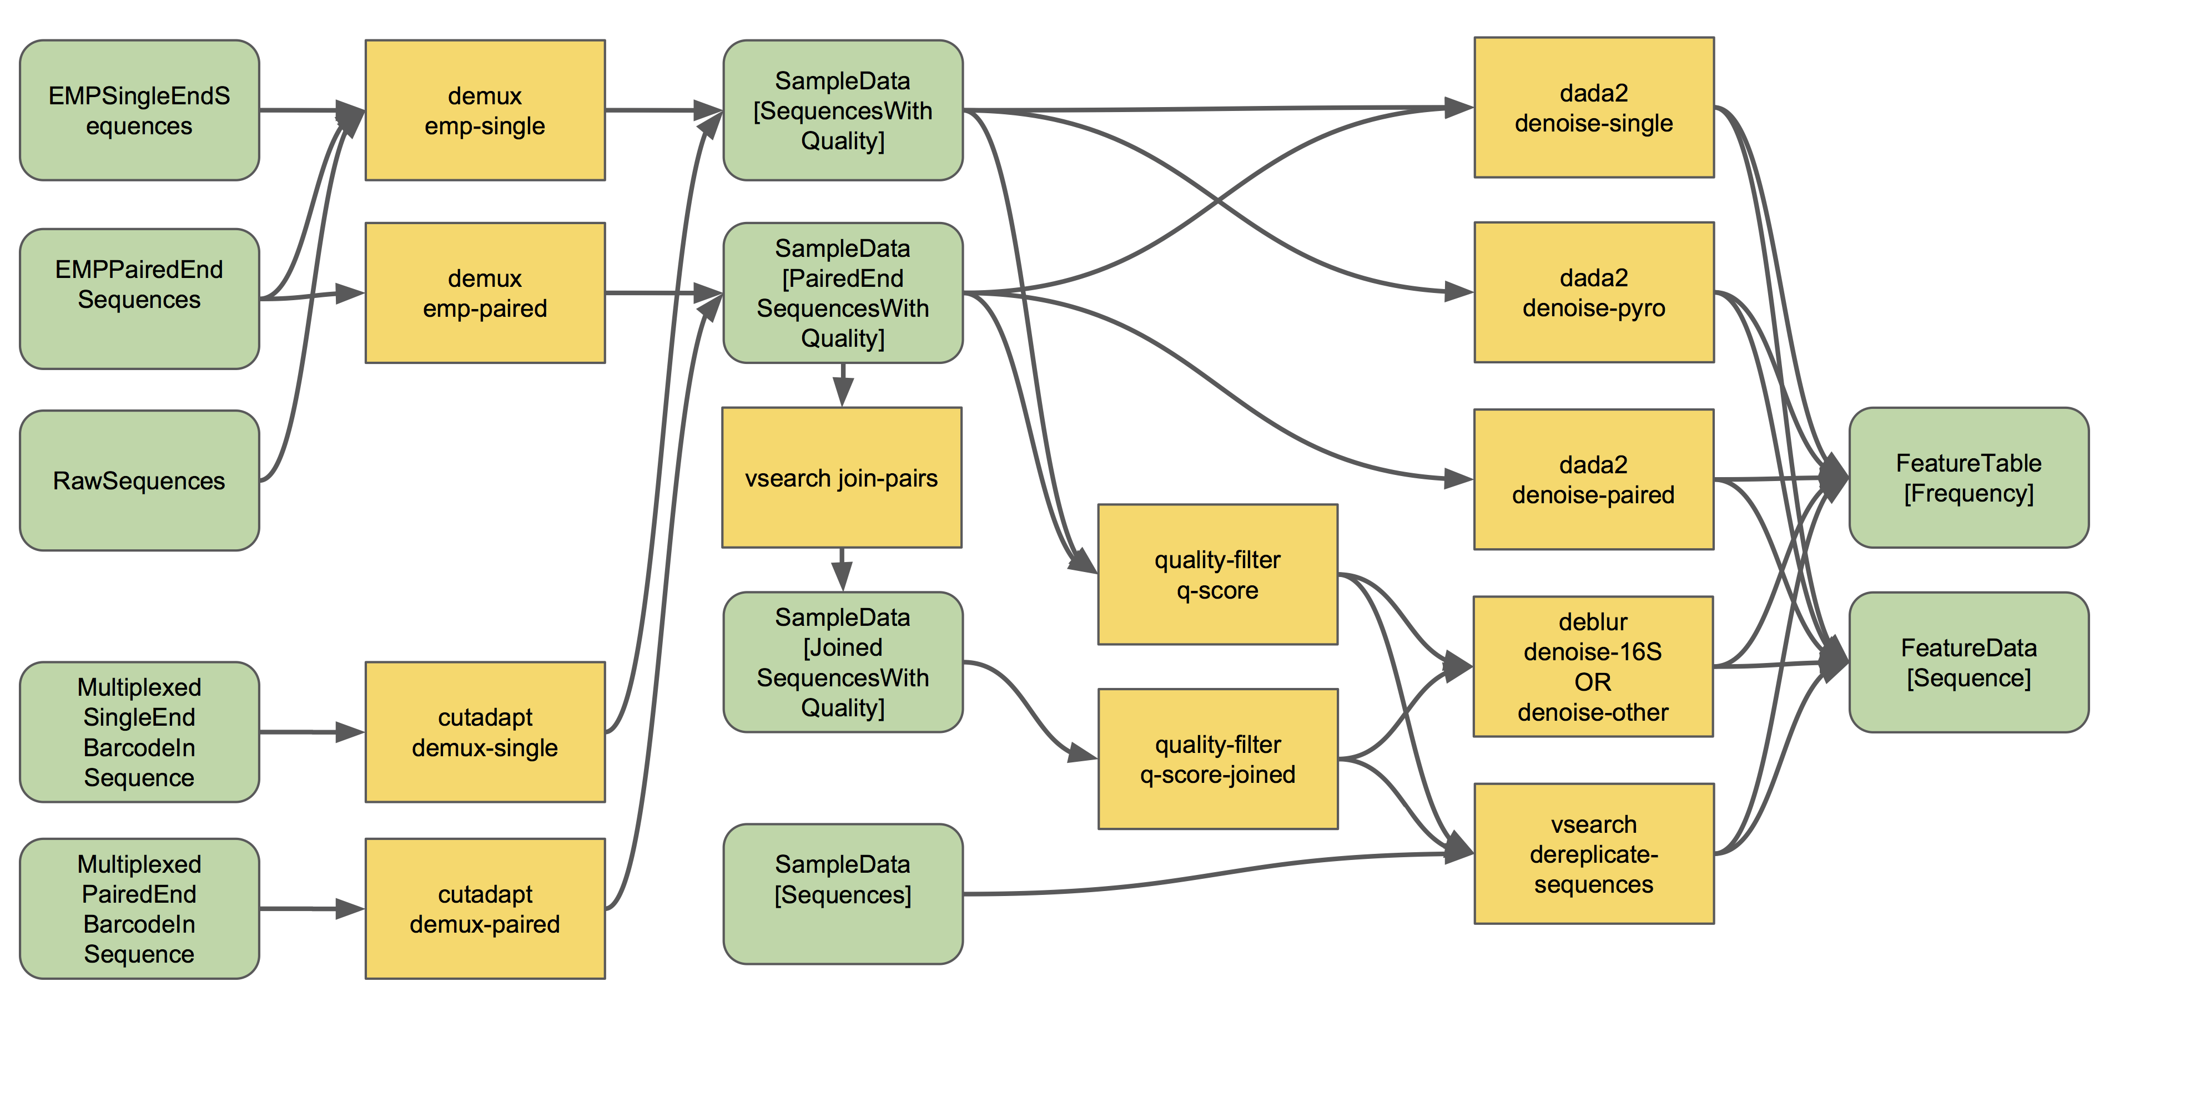
Demultiplex, Data Import, Denoising
(출처: Overview of QIIME 2 Plugin Workflows)

Slide 11
DADA2
Filtering - PCR errors and sequence errors
Dereplication - Consolidating identical reads
merging paired reads
removing chimeras artifacts of PCR that combine sequences from two or more biological templates

Slide 12
Clustering
Amplicon Sequence Variants (ASVs)
Each unique sequence (read) is treated as a distinct entity.
ex) ASV1 - ACTGCTGATCGATCGATCGATTTATGTCGA
ASV2 - ATTGCTGATCGATCGATCGATTTATGTCGA
ASV3 - ACTGCTGATCGATCGATCGATTTATGTCGG
ASV4 – ATTGCTGATCGATCGATCGATTTATGTCGG
...
Operational Taxonomic Unit (OTUs)
OTUs are clusters of similar sequence reads.
OTU1
OTU2
A1
A9
A2
A4
A
10
A3
A6
OTU4
OTU3
A5
A7
A8

Slide 13
Singleton
A unique sequence variant: It appears only once acrossall samples in a sequencing dataset.
An indicator of rarity or possible sequencing error: Singletons often reflect rare species within the microbial community but can also result from sequencing errors, PCR errors, or other technical artifacts.

Slide 14
Thanks!
Do you have any questions?
curly1215@naver.com
+82 10 4995 1833

